Slide 1
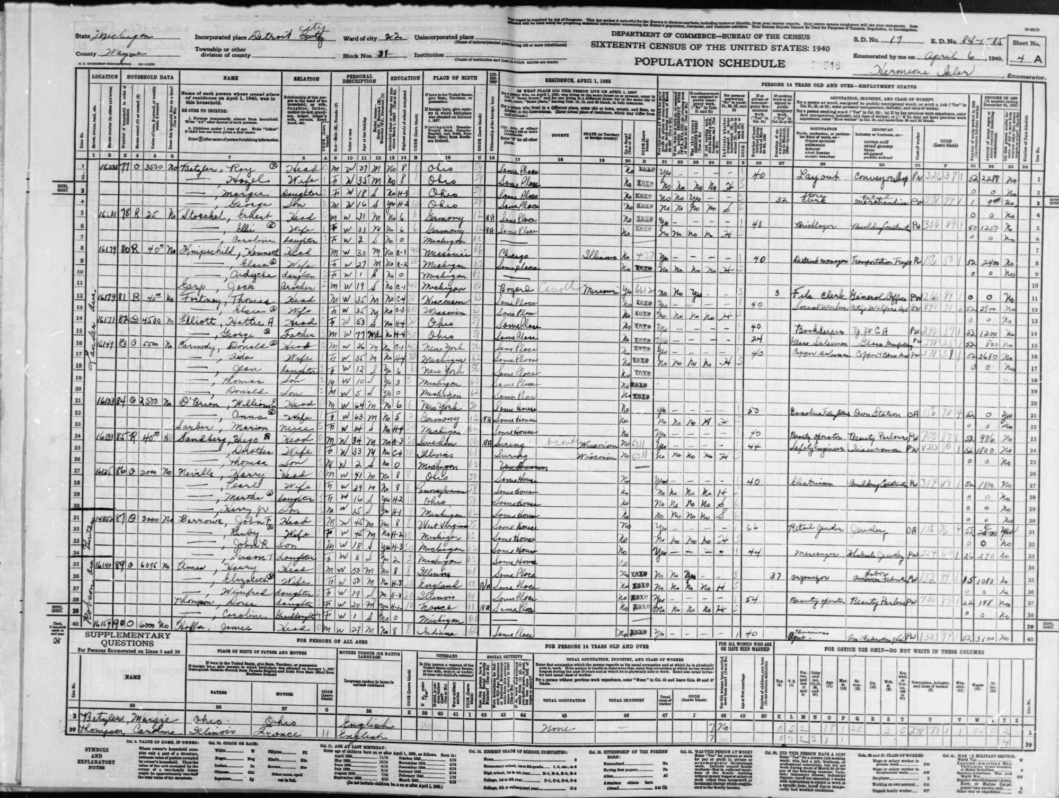
Data types and statistical thinking
Geog4300/6300
Jerry Shannon

Slide 2
Topics for today
Defining terms
Types of data
Statistical thinking

Slide 3
Setting the stage:
Write down a research question you’re currently interested in pursuing.

Slide 4

Variable: a category of observation that takes on obtainable values or outcomes for each observation.
Variables: card value, suit, color, etc.

Slide 5

Observation: A single case with recorded values for all variables.
Pick a card. Any card.

Slide 6
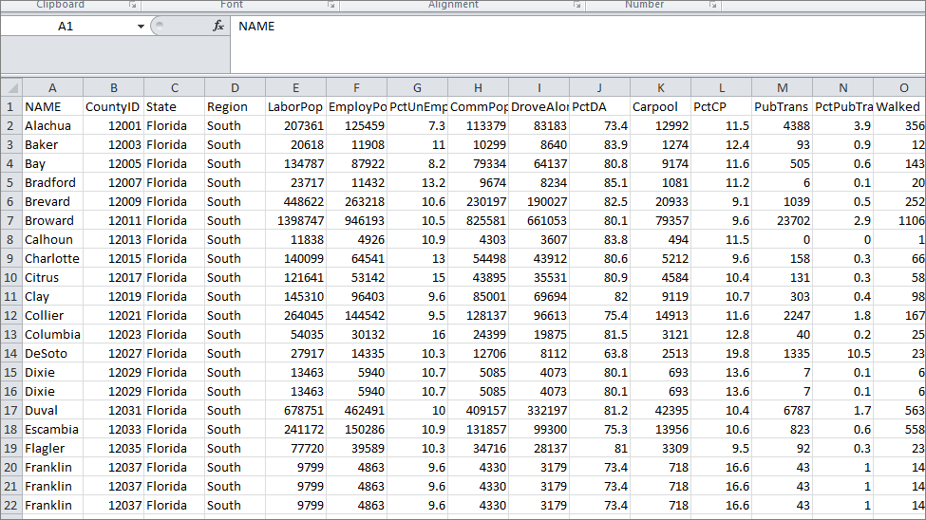
Variables in red
Observations in blue

Slide 7
Dependent and independent variables
dependent: the variable that you want to explain
independent: the variable that you use to explain the dependent one
How does the ___________________
explain the ___________________.

Slide 8
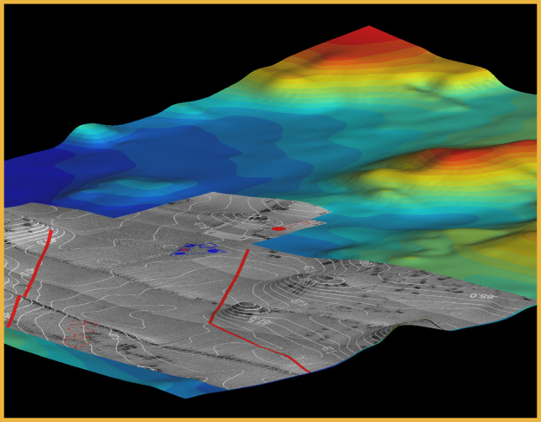
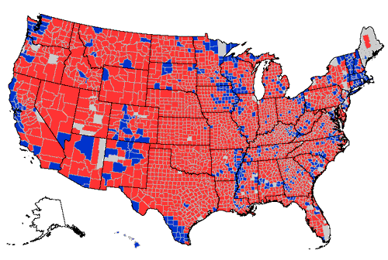
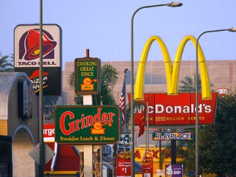
Dependent and independent variables
typical geographic questions:
in what way does elevation influence temperature?
are voters more conservative in the South than the Northeast?
Are fast food restaurants more likely to cluster together than tire repair shops?
Notes:
What are the dependent and independent variables in each of these examples?

Slide 9
Do you have dependent and independent variables in your research question?
If so, what are they?

Slide 10
Levels of measurement
refers to variables, not observations or their values
How is suit as a variable different from number?

Slide 11
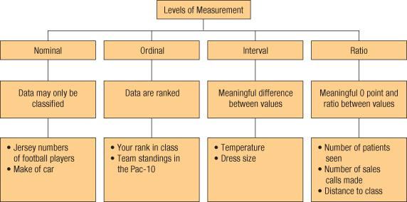
Levels of measurement
Four types:
Categorical (Nominal)
Ordinal
Interval
Ratio

Slide 12
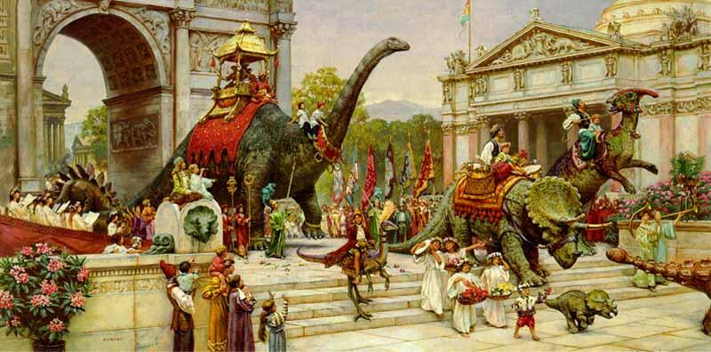
Categorical data
Variables whose values vary in kind or in name; no implied ranking or ordering. Also called “nominal” data.
Some categorical data can be ordered (e.g. geologic periods)
http://emilypothast.files.wordpress.com
Notes:
Come up with some examples of nominal variables that could be used to study Georgia.
Notice that these variables can’t be directly ranked.

Slide 13
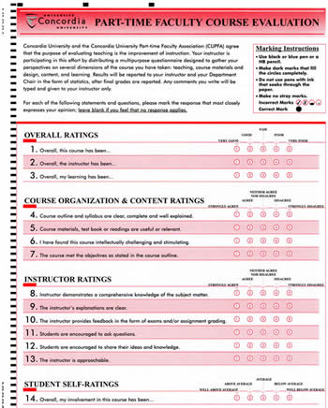
Ordinal data
Numerical and implied rank order, but difference between levels is not defined.
Notes:
Key to remember here is that there’s no mathematical observations that can be done with ranked data.
Example: Teaching evaluations.
Is a teacher with a 4 average twice as good as one with a 2?
Other examples of ordinal data?
College football rankings
Likert scales of all types

Slide 14
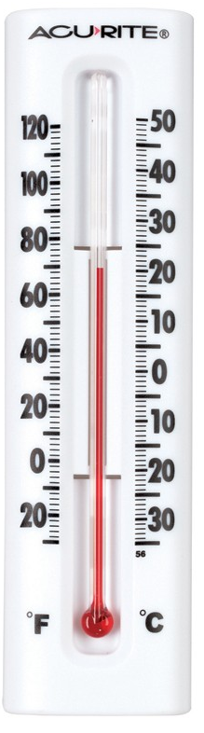
Interval data
Variables whose values can be compared by intervals, but not ratios
**No meaningful zero.**
Can only add and subtract.
Examples: temperature, time (year or clock), IQ tests
Notes:
You can tell exact distances between values; you can add or subtract, but not multiply or divide interval values

Slide 15
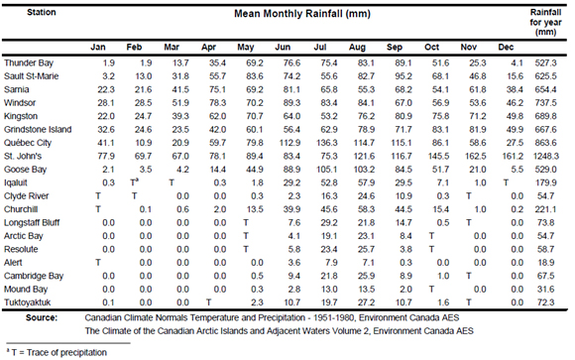
Ratio data
Variables whose values can be compared by taking ratios
Can add, subtract, multiply, divide
Notes:
you can tell exact distances between values; you can add or subtract, but not multiply or divide interval values

Slide 16
Levels of measurement
What kind of data is it?
Letter grades on an essay exam
Year of an important event
Number of students from each country in a large course
Flavors of ice cream
Grams of fat in ice cream
% of consumers who prefer particular flavors of ice cream
Notes:
you can tell exact distances between values; you can add or subtract, but not multiply or divide interval values

Slide 17
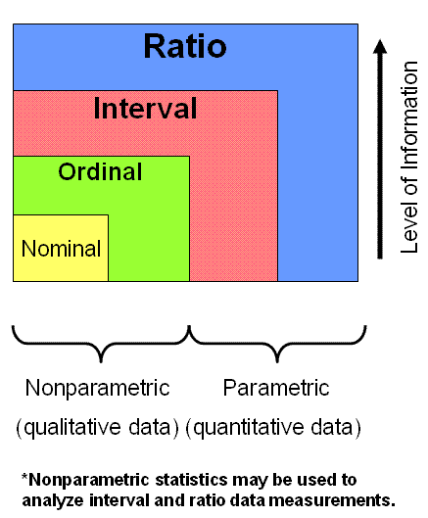
six-sigma-material.com

Slide 18
Classify the data in our course survey
Cartegorical
Ordinal
Interval
Ratio
https://docs.google.com/forms/d/e/1FAIpQLScMQxPWMa8mrh98QzIPO6GtcRRWU_agX6oGPGEPeCtfCeBsXA/viewform?usp=sf_link
Notes:
you can tell exact distances between values; you can add or subtract, but not multiply or divide interval values

Slide 19
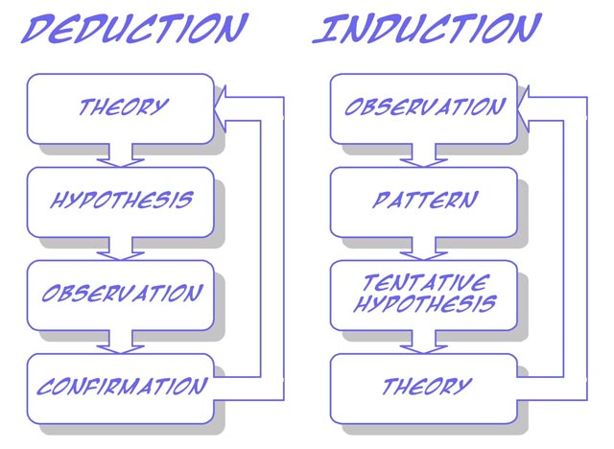
Revisiting models of statistical thinking
http://www.soes.soton.ac.uk
Notes:
Two models of statistical analysis.

Slide 20
Two models of statistical reasoning
Deductive/Hypothesis driven
Theory
Analysis
Hypothesis
Experiment
Notes:
Two models of statistical analysis.
The first is hypothesis driven, where a test is created specifically to test a specific hypothesis: neighborhood racial composition is a predictor of college degree attainment
Clear and focused, based on expanding existing research

Slide 21
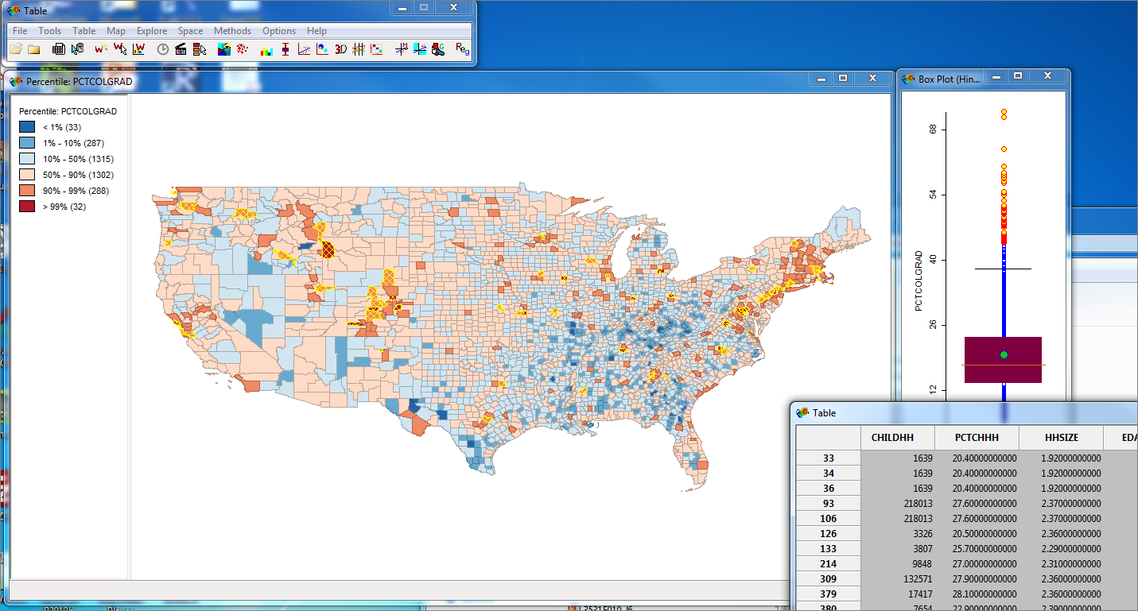
Two models of statistical reasoning
2. Inductive/Exploratory Data Analysis
ESRI
Notes:
Exploratory data analysis is another alternative.
Particularly popular now working with large datasets.
Focus is on working with data and trying to visualize it in multiple ways. Look for patterns that appear in the data that may not be captured by standard statistical models.
Focus is on surprises within the data revealed through multiple passes through it.
May suggest more hypothesis driven experiments or highlight the need for better data.
Example from last time—”elbow” in the connection between HS and college graduation data.

Slide 22
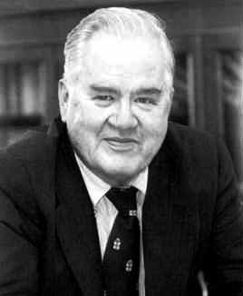
Inductive/Exploratory Data Analysis
John Tukey
“Numerical quantities focus on expected values, graphical summaries on unexpected values.”
Notes:
Exploratory data analysis is another alternative.
Particularly popular now working with large datasets.
Focus is on working with data and trying to visualize it in multiple ways. Look for patterns that appear in the data that may not be captured by standard statistical models.
Focus is on surprises within the data revealed through multiple passes through it.
May suggest more hypothesis driven experiments or highlight the need for better data.
Example from last time—”elbow” in the connection between HS and college graduation data.

Slide 23
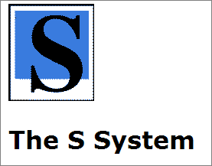

Tukey encouraged the development of the S programming language at Bell Labs.
R is one descendent of this S software package.
Notes:
Exploratory data analysis is another alternative.
Particularly popular now working with large datasets.
Focus is on working with data and trying to visualize it in multiple ways. Look for patterns that appear in the data that may not be captured by standard statistical models.
Focus is on surprises within the data revealed through multiple passes through it.
May suggest more hypothesis driven experiments or highlight the need for better data.
Example from last time—”elbow” in the connection between HS and college graduation data.

Slide 24
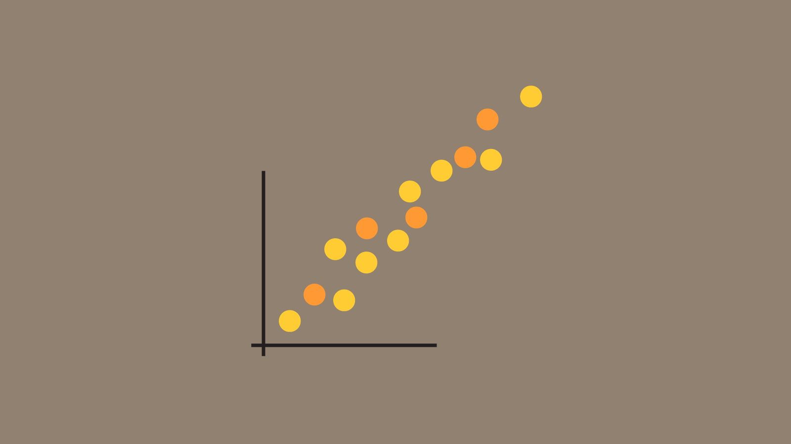
Ways to visualize data:
Scatterplots
http://www.datalabs.com.au/powerpoint-data-presentations/
Notes:
Exploratory data analysis is another alternative.
Particularly popular now working with large datasets.
Focus is on working with data and trying to visualize it in multiple ways. Look for patterns that appear in the data that may not be captured by standard statistical models.
Focus is on surprises within the data revealed through multiple passes through it.
May suggest more hypothesis driven experiments or highlight the need for better data.
Example from last time—”elbow” in the connection between HS and college graduation data.

Slide 25
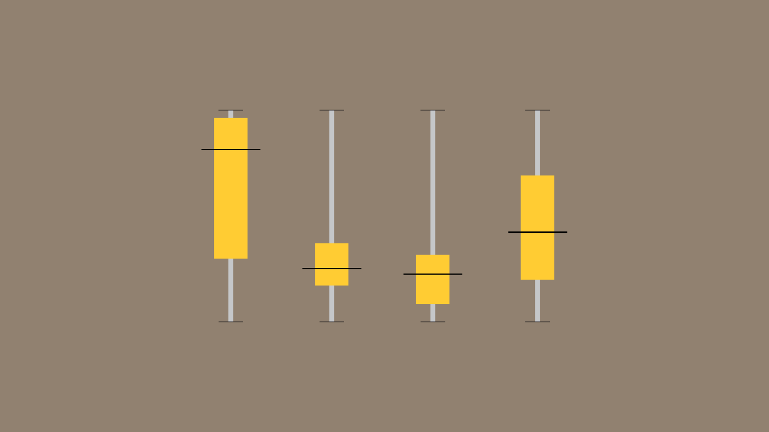
Ways to visualize data:
Boxplots
http://www.datalabs.com.au/powerpoint-data-presentations/
Notes:
Exploratory data analysis is another alternative.
Particularly popular now working with large datasets.
Focus is on working with data and trying to visualize it in multiple ways. Look for patterns that appear in the data that may not be captured by standard statistical models.
Focus is on surprises within the data revealed through multiple passes through it.
May suggest more hypothesis driven experiments or highlight the need for better data.
Example from last time—”elbow” in the connection between HS and college graduation data.

Slide 26
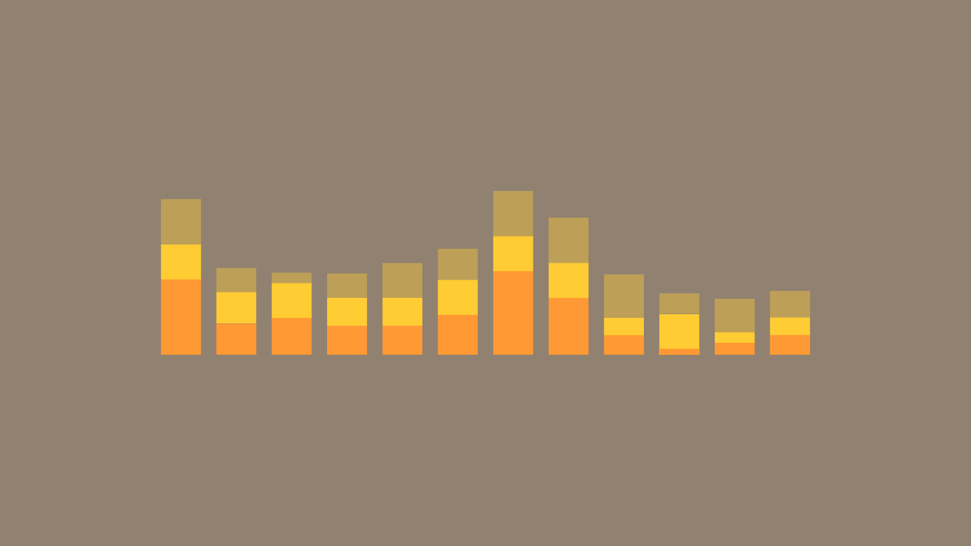
Ways to visualize data:
Bar charts/histograms
http://www.datalabs.com.au/powerpoint-data-presentations/
Notes:
Exploratory data analysis is another alternative.
Particularly popular now working with large datasets.
Focus is on working with data and trying to visualize it in multiple ways. Look for patterns that appear in the data that may not be captured by standard statistical models.
Focus is on surprises within the data revealed through multiple passes through it.
May suggest more hypothesis driven experiments or highlight the need for better data.
Example from last time—”elbow” in the connection between HS and college graduation data.

Slide 27
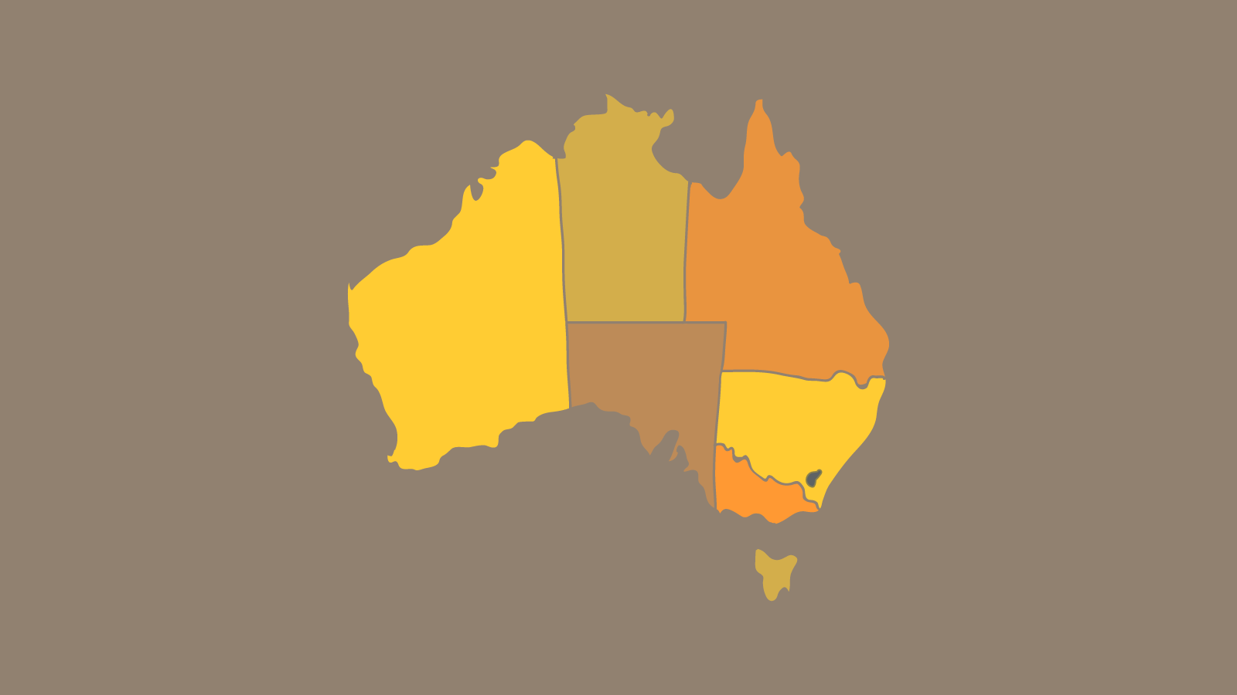
Ways to visualize data:
Choropleth maps
http://www.datalabs.com.au/powerpoint-data-presentations/
Notes:
Exploratory data analysis is another alternative.
Particularly popular now working with large datasets.
Focus is on working with data and trying to visualize it in multiple ways. Look for patterns that appear in the data that may not be captured by standard statistical models.
Focus is on surprises within the data revealed through multiple passes through it.
May suggest more hypothesis driven experiments or highlight the need for better data.
Example from last time—”elbow” in the connection between HS and college graduation data.

Slide 28

Ways to visualize data:
Star plot/radar plot
http://www.datalabs.com.au/powerpoint-data-presentations/
Notes:
Exploratory data analysis is another alternative.
Particularly popular now working with large datasets.
Focus is on working with data and trying to visualize it in multiple ways. Look for patterns that appear in the data that may not be captured by standard statistical models.
Focus is on surprises within the data revealed through multiple passes through it.
May suggest more hypothesis driven experiments or highlight the need for better data.
Example from last time—”elbow” in the connection between HS and college graduation data.

Slide 29
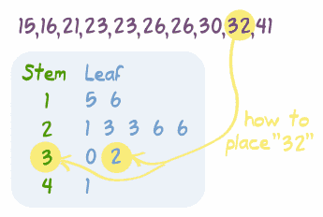
Ways to visualize data:
Stem and leaf plots
http://www.datalabs.com.au/powerpoint-data-presentations/
Notes:
Exploratory data analysis is another alternative.
Particularly popular now working with large datasets.
Focus is on working with data and trying to visualize it in multiple ways. Look for patterns that appear in the data that may not be captured by standard statistical models.
Focus is on surprises within the data revealed through multiple passes through it.
May suggest more hypothesis driven experiments or highlight the need for better data.
Example from last time—”elbow” in the connection between HS and college graduation data.

Slide 30
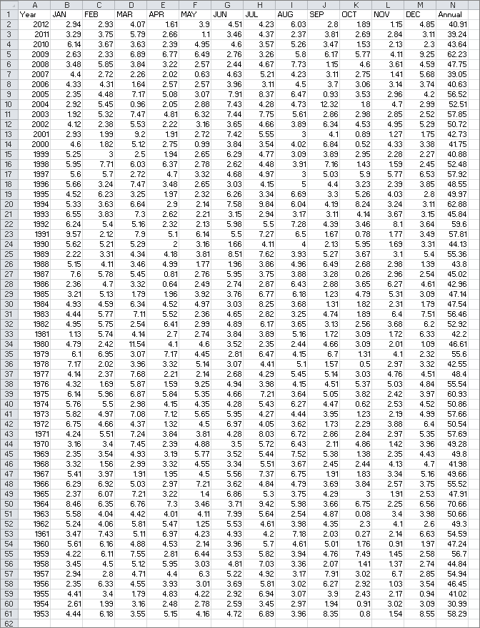
Data Exploration
Annual Rainfall for Georgia, 1953-2012

Slide 31
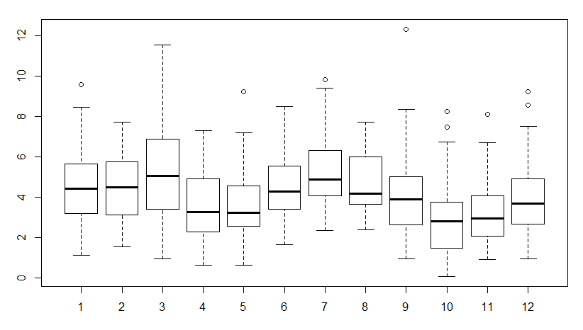
Data Exploration
Boxplot of data-What do you notice?

Slide 32
Data Exploration
Difference between March and September?

Slide 33
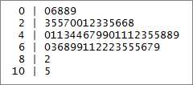
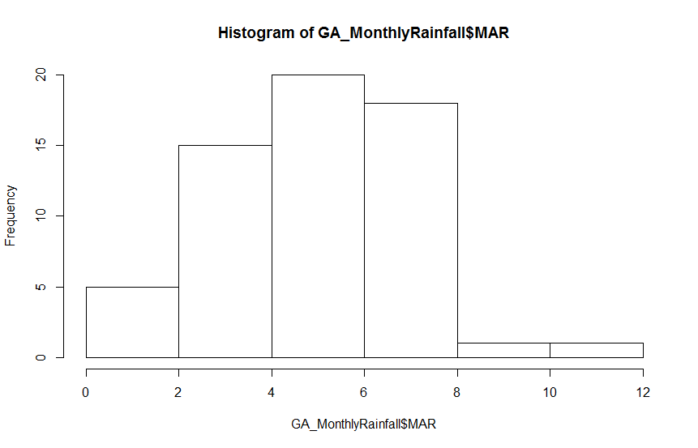
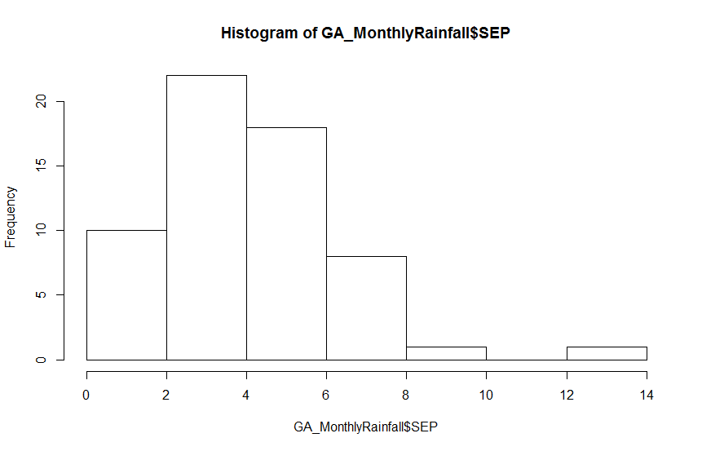
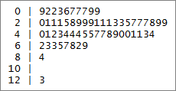
Data Exploration
Stem and leaf charts, histograms
March
September

Slide 34
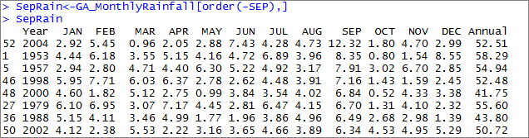
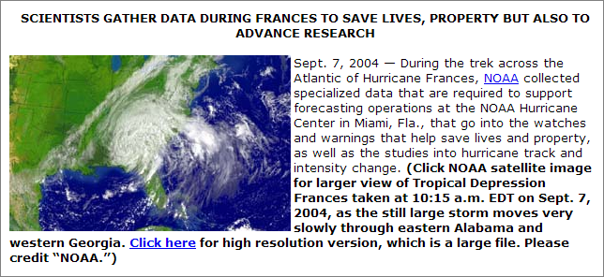
Data Exploration
Which year?
http://www.noaanews.noaa.gov/stories2004/s2316.htm
Notes:
Where could we go at this point? Depends on what we’re interested in.
Could cut out this outlier month from the analysis if you’re interested in “normal” weather patterns
Or could be start of a project on how hurricanes affect weather data (and weather) in the region. Or how ecosystems respond differently to outlier events to regular ones (wet March vs. Sept. hurricane).
Important part of this: we didn’t start out with a theory we wanted to test. Rather, we started with data which led to questions. Different kind of process.

Slide 35
The GeoDa software package also encourages EDA.
Notes:
Where could we go at this point? Depends on what we’re interested in.
Could cut out this outlier month from the analysis if you’re interested in “normal” weather patterns
Or could be start of a project on how hurricanes affect weather data (and weather) in the region. Or how ecosystems respond differently to outlier events to regular ones (wet March vs. Sept. hurricane).
Important part of this: we didn’t start out with a theory we wanted to test. Rather, we started with data which led to questions. Different kind of process.

